Slide 1
HEALTH AND SPA WEB-SITE
Team members:
NAME : DEVIKA BENIWAL - 09BIT016
E-MAIL: beniwal.devika@gmail.com

Slide 2
PROBLEM STATEMENT
Design a website that provides customers a virtual sense of what a salon will be like if they actually go to visit it. The website provides information about the latest trends , making it very easy for taking business online .It should be designed to reach a wider customer base, thereby increasing sales .This should Endeavour to make the work of clients and managers easy and accommodating. The clients should be able to select their stylists based on the availability and make appointments .The manager should be able to update information about the working staff and also add new makeup styles that go with the current trends. It should provide a list of various beauty products that are sold along with the necessary information the customer can buy them all.

Slide 3
REQUIREMENT
SOFTWARE REQUIREMENTS
Operating system : windows 7
Browser front end : Google chrome/mozilla firefox
Database layer : Mysql,Excel Sheets
Server side scripting : JavaScript, PHP
Client side scripting : HTML,CSS
Connection protocol : HTTP,SMTP

Slide 4
HARDWARE REQUIREMENTS
Monitor/LCD display
Keyboard, Mouse
Memory(Hard disk)
Processing element-RAM(2-4 GB)

Slide 5
ARCHITECTURE SPECIFICATION
List of pages
Home page
2 About us
Services offered
On line Shopping
Products
Feedback
Booking appointment
Navigation

Slide 6
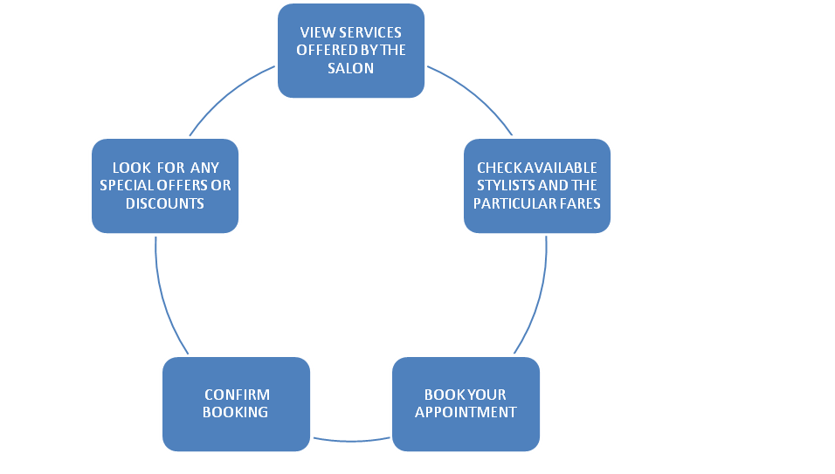
GENERAL OVERVIEW

Slide 7
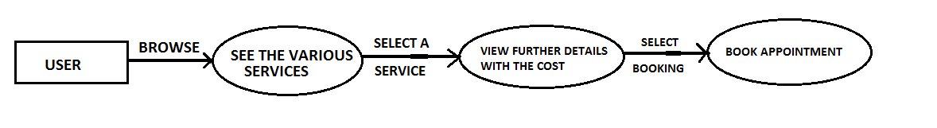
MODULE 1: Customers checks the various options

Slide 8
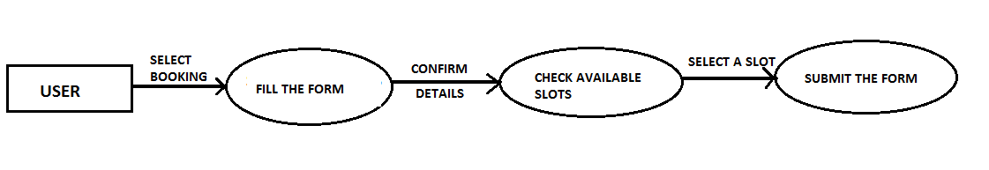
MODULE 2: Users book appointments

Slide 9
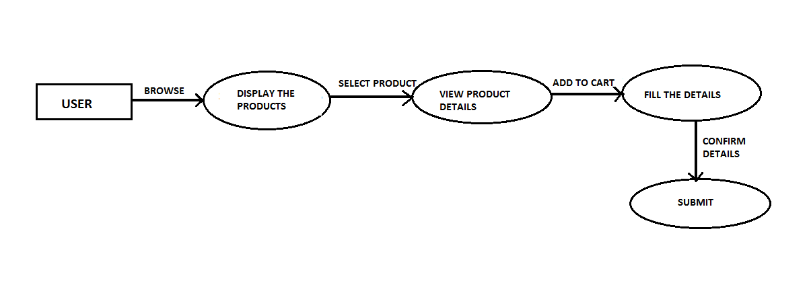
MODULE 3: Users can buy the products

Slide 10
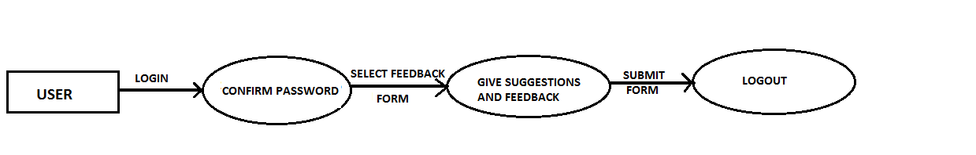
MODULE 4: Users post feedback

Slide 11
THANK YOU

